Slide 1
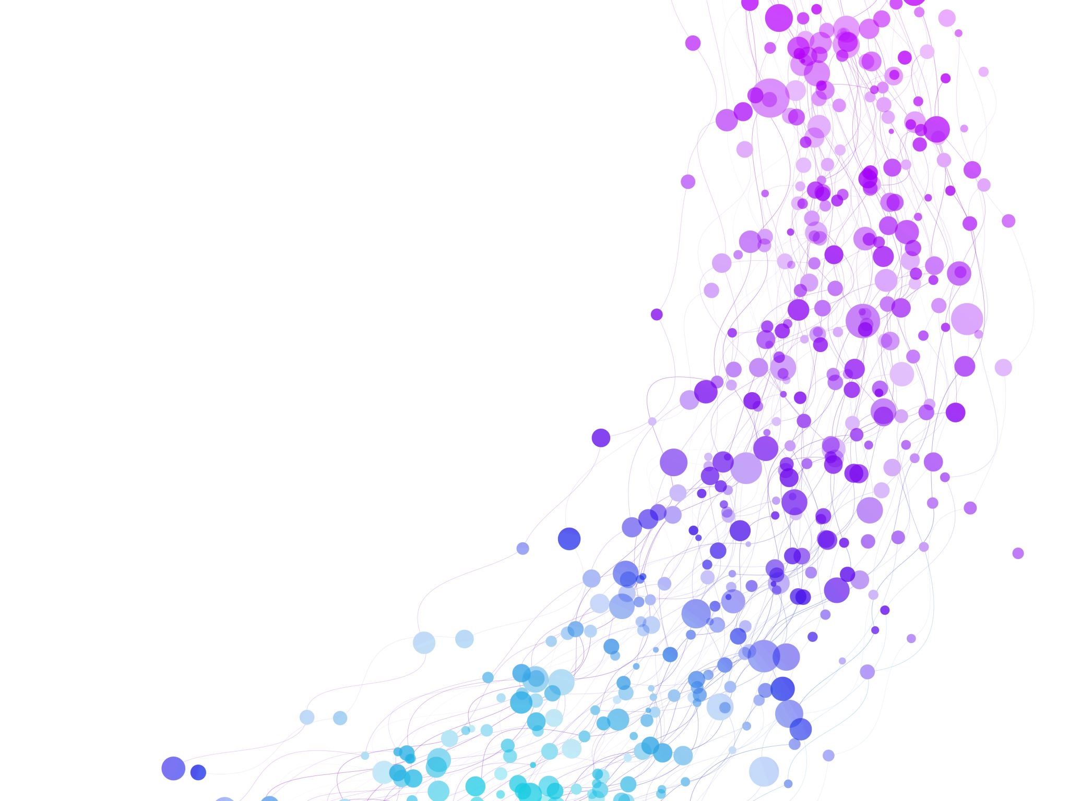


Morphology and Named Entity Recognition (NER)
Session No.: 9 Course Name: Natural language processing Course Code: R1UC616C Instructor Name: Mr. Amit Yadav

Slide 2
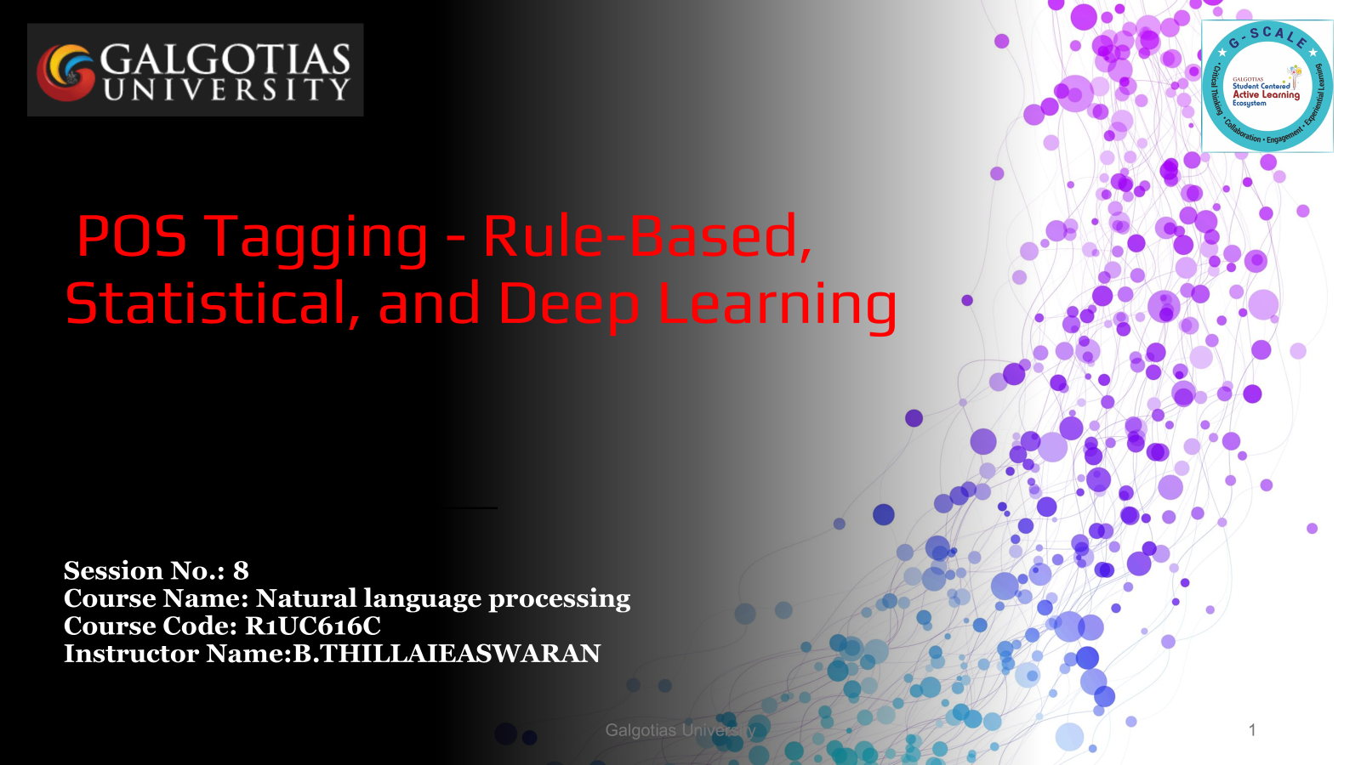
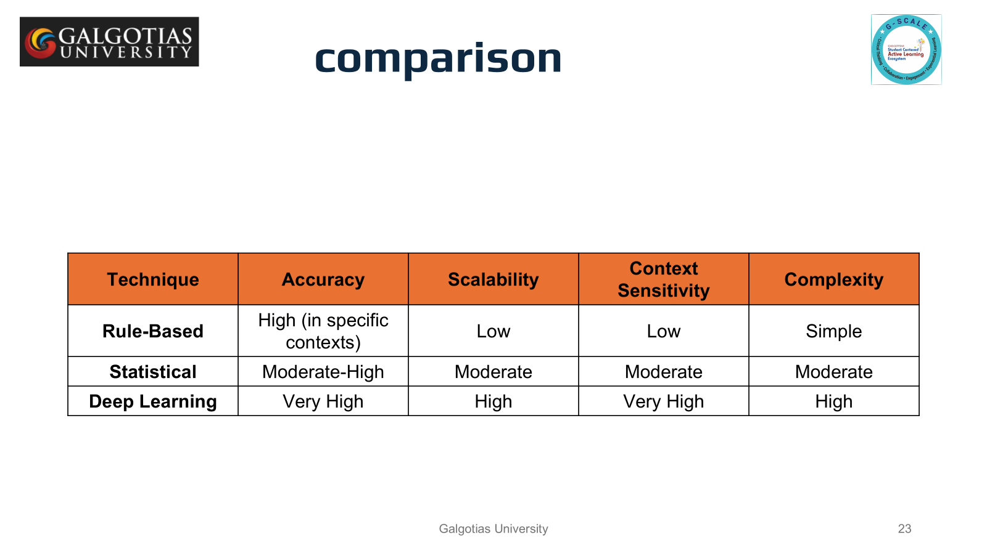
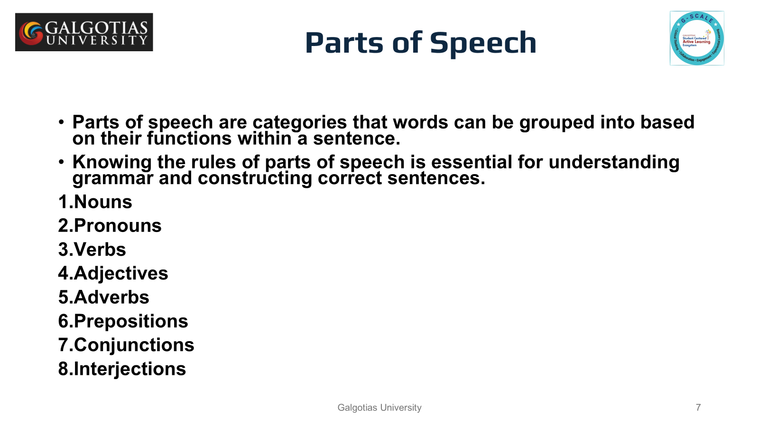
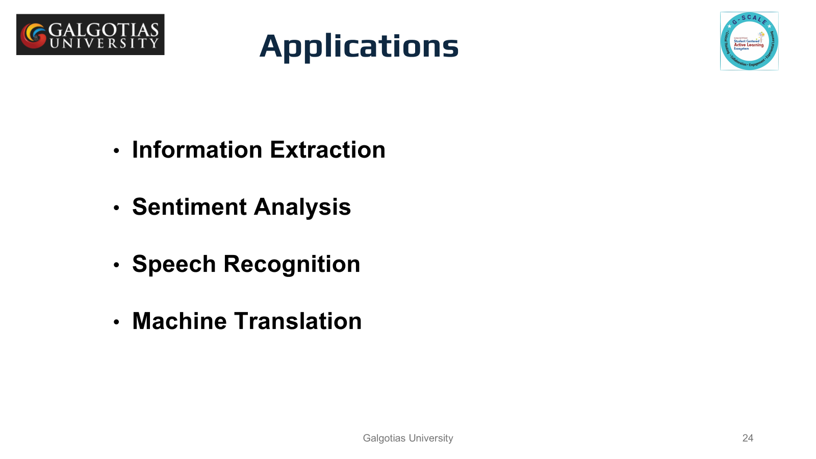
Reflect on the responses of post session activity

Slide 3


Ask Questions
What is mean by morphology?
Example for morphology

Slide 4
At the end of this session students will be able to know
Analyze and Decompose Words Morphologically: Actively break down words into their morphemes (root, prefixes, suffixes)
Identify and Classify Named Entities in Text: Collaboratively annotate real-world text data to recognize named entities (persons, organizations, locations, etc.)

Slide 5
Session Outline
1 Definition of morphology and NER
2 Understanding with examples
3 classroom activities (morphology and wooclap)

Slide 6
What is Morphology?
The study of word formation how words are built up from smaller pieces. Identification, analysis, and description of the structure of a given language's MORPHEMES.
Bullet Points:
It analyzes how words are built from morphemes (smallest units of meaning).
Focuses on affixes (prefixes, suffixes), roots, and stems.
Helps in understanding how words change in different contexts.

Slide 7
Morphemes
Smallest meaning bearing units constituting a word
Morphemes
Stem
Affixes
Prefixes
Suffixes
tree, go, fat
post - (postpone)
-ed (tossed)
Stem
Prefix
Suffix
reconsideration
re
consider
ation
Affixes in Hindi?

Slide 8
Examples of Morphology
Text: Morphology examines the internal structure of words.
Bullet Points:
Unhappiness → "Un-" (prefix), "happy" (root), "-ness" (suffix)
Dogs → "dog" (root), "-s" (plural suffix)
Rewriting → "Re-" (prefix), "write" (root), "-ing" (suffix)

Slide 9
Why is Morphology Important in NLP?
Helps machines understand variations of words and their meanings.
Enables more accurate text processing (stemming, lemmatization).
Important for applications like search engines, machine translation, and speech recognition.

Slide 10
Types of Morphology
Inflectional Morphology – Deals with variations in a word to express grammatical properties (e.g., tense, number, gender).
Example:
"walk" → "walks" (third-person singular)
"play" → "played" (past tense)
Derivational Morphology – Deals with creating new words by adding prefixes or suffixes.
Example:
"happy" → "unhappy" (prefix)
"nation" → "nationalize" (suffix)

Slide 11
Problems in Morphological Analysis
Productivity
False Analysis
Bound Base Morphemes

Slide 12
Productivity
Problem:
Morphology is highly productive, meaning new words and word forms are constantly created.
This makes it difficult to build exhaustive morphological analyzers since new words (e.g., slang, domain-specific terms) keep emerging.
Example:
The verb Google led to Googling, Googled, and Googler (noun).
A rule-based system may fail to recognize new word formations like Googlify or Googlization.
Solution:
Machine learning models (like deep learning and transformers) help by learning patterns rather than relying on fixed rules.
Morphological generation models help predict unseen word formations.

Slide 13
False analysis
Problem:
Sometimes, words are incorrectly segmented into morphemes, leading to errors in meaning or processing.
This happens due to homographs (words with the same spelling but different meanings) or over-segmentation.
Example:
Incorrect Segmentation:
butcher → butch + -er (Incorrect, because butch is not a root here)
corner → corn + -er (Incorrect, since corner does not mean "one who corns")
Homograph Issue:
flies → May refer to the verb fly (third-person singular) or the noun flies (plural of fly).
Solution:
Context-based NLP models like BERT can help differentiate word meanings.
Hybrid approaches combining rule-based and statistical methods improve accuracy.

Slide 14
Bound Base Morphemes
Problem:
A bound base morpheme cannot stand alone as a word and must attach to another morpheme.
Many morphological analyzers assume a clear distinction between roots and affixes, making it hard to process bound bases.
Example:
Receive, deceive, perceive → The base -ceive has no meaning when isolated.
Infer, refer, confer → The base -fer does not exist independently.
Solution:
Lexical databases (like WordNet) can help by storing bound bases.
Neural networks trained on large corpora can identify and process bound morphemes effectively.

Slide 15
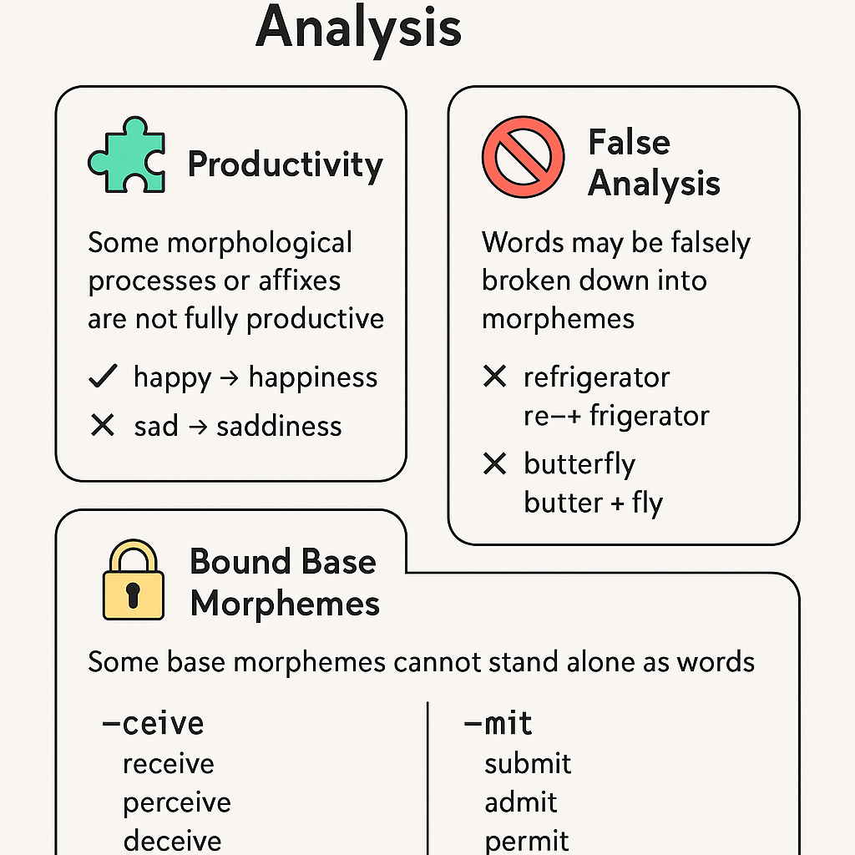

Slide 16
NLP Techniques for Morphology
Morphology in NLP deals with understanding and processing the structure of words.
Various techniques are used to analyze and manipulate morphemes (the smallest units of meaning in a language).
These techniques help in text preprocessing, machine translation, speech recognition, and more.

Slide 17
1. Tokenization
Definition: Splitting text into words, sub-words, or morphemes.
Types:
Word Tokenization – Splitting text into individual words.
Sub-word Tokenization – Breaking words into smaller meaningful parts (useful in languages with complex morphology).
Character Tokenization – Used for languages with no spaces (e.g., Chinese, Japanese).
Example:
Input: "unhappiness"
Output (Subword Tokenization): ["un", "happy", "ness"]
Tools:
NLTK, SpaCy, Hugging Face's Tokenizers

Slide 18
2. Stemming
Definition: Reducing words to their root form by removing suffixes.
Limitation: May produce non-meaningful words (e.g., "running" → "run", but "argued" → "argu").
Popular Algorithm:
Porter Stemmer (common for English)
Lancaster Stemmer (aggressive stemming)
Snowball Stemmer (supports multiple languages)
Example:
Input: ["running", "runs", "runner"]
Output: ["run", "run", "run"]
Tools:
NLTK, SpaCy

Slide 19
3. Lemmatization
Definition: Mapping words to their base or dictionary form (lemma).
Advantage over Stemming: Considers the word’s meaning and part of speech.
Example:
Input: ["better", "running", "mice"]
Output: ["good", "run", "mouse"]
Tools:
WordNet Lemmatizer (NLTK)
SpaCy

Slide 20
4. Morphological Segmentation
Definition: Splitting words into their morphemes (roots and affixes).
Example:
Input: "nationalization"
Output: ["nation", "-al", "-ize", "-ation"]
Tools:
Morfessor (for unsupervised segmentation)
Polyglot

Slide 21
What is Named Entity Recognition (NER)?
Text: Named Entity Recognition is an NLP task that identifies and classifies named entities in text.
NER focuses on finding entities like names, locations, organizations, and dates.
Categorizes words into predefined classes like person, organization, location, etc.
Key for information extraction and understanding context in text.

Slide 22
Examples of NER
Text: Let's look at an example sentence and how NER works.
Example:
Sentence: "Barack Obama was born in Hawaii on August 4, 1961."
Person: "Barack Obama"
Location: "Hawaii"
Date: "August 4, 1961"

Slide 23
NER in Action
Text: NER systems classify and extract valuable information from unstructured text.
Bullet Points:
Useful in information retrieval (search engines).
Helps in data extraction from documents, articles, and news.
Vital for chatbots and virtual assistants to understand user input.

Slide 24
How Morphology and NER Work Together
Text: Morphology helps improve NER systems by handling word variations and complex forms.
Bullet Points:
Morphology helps in recognizing entities in their different forms (e.g., plural or possessive forms).
It aids in identifying proper names despite morphological changes (e.g., "Apple" vs. "Apples").
Morphological analysis helps NER in languages with rich inflection or compound words.

Slide 25
Applications of Morphology and NER
Text: Both concepts play key roles in various NLP applications.
Bullet Points:
Search engines: Help improve search accuracy by understanding different forms of a word.
Machine Translation: Morphology helps in accurate translation of words.
Chatbots and Virtual Assistants: NER helps in understanding user commands and providing contextually appropriate responses.
Text Analytics: Helps in analyzing sentiment, extracting information from documents.

Slide 26
Class room activity : Morpheme
Prefix Cards: un-, re-, dis-, pre-, mis-
Root Cards: happy, play, connect, break, understand
Suffix Cards: -ing, -ed, -ness, -ful, -able

Slide 27
Creating Words
Text:
Select a prefix, root, and suffix to form a word.
Example:
Prefix: re-, Root: play, Suffix: -ing → Replaying
Tell the meaning of the word (real or invented).

Slide 28
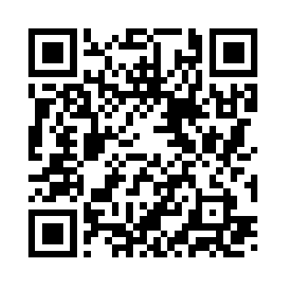
Review and Reflection from students
Participation link
QOAOZP
https://app.wooclap.com/QOAOZP?from=instruction-slide

